Slide 1
Deep Learning
Regularization & Framework
Artem Chumachenko

Slide 2
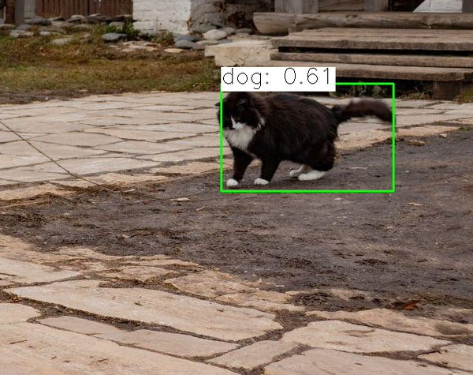
:(

Slide 3
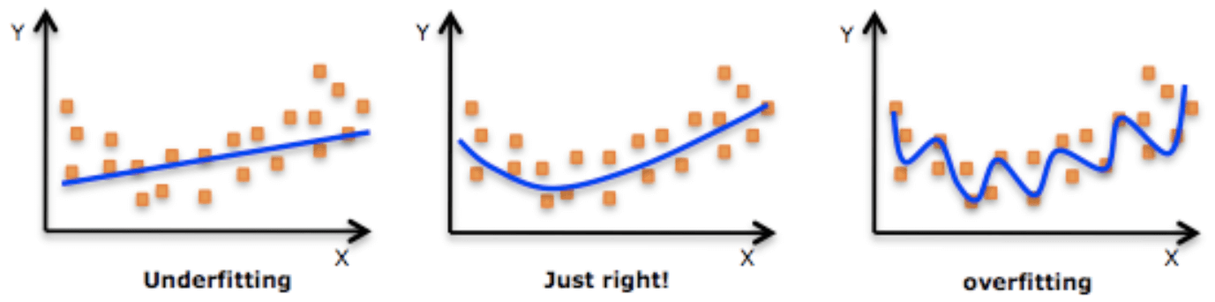
Overfitting vs underfitting

Slide 4
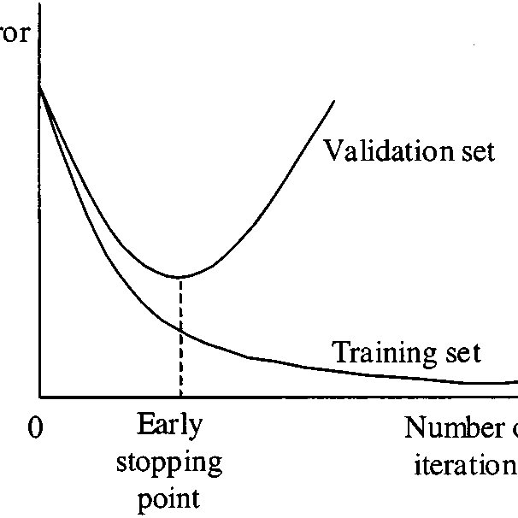
Early Stopping

Slide 5
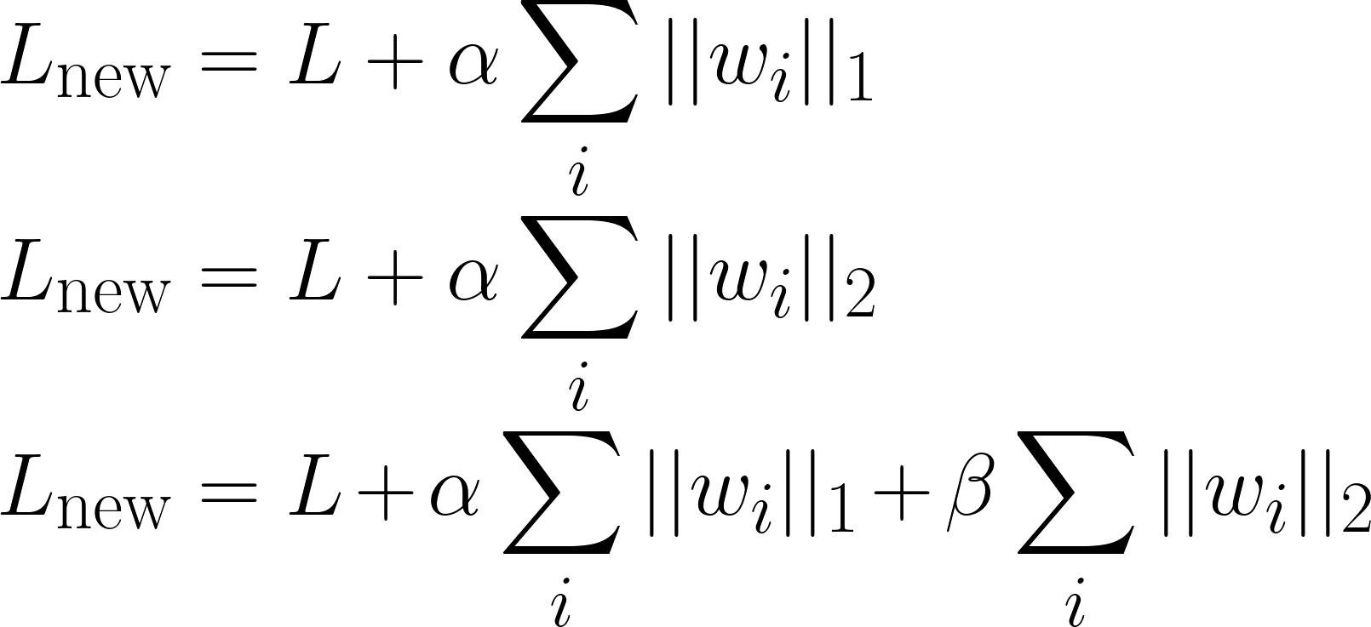
Weight Decay

Slide 6
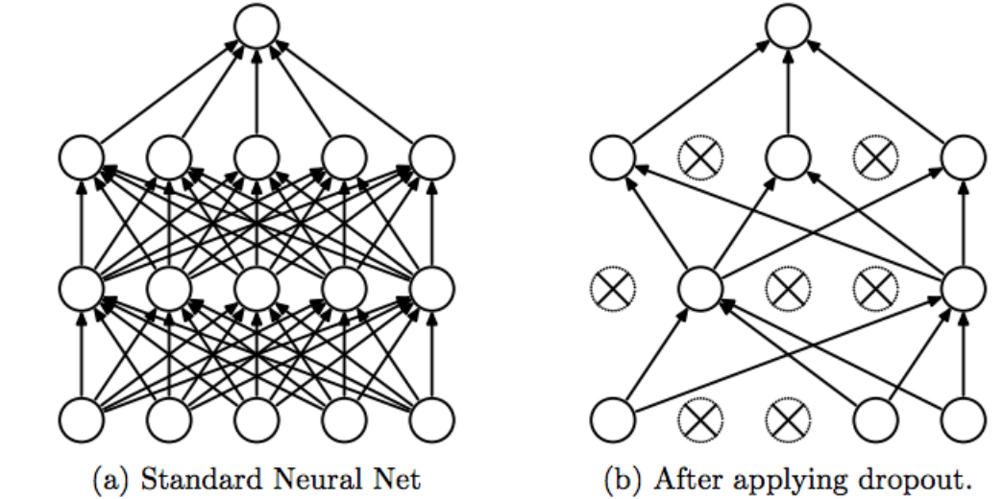
Dropout

Slide 7
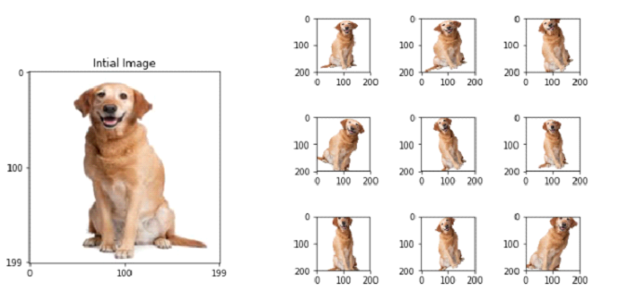
Data Augmentation

Slide 8
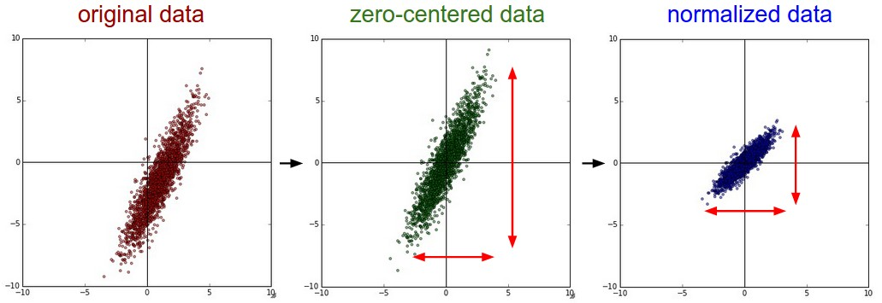
Normalization

Slide 9
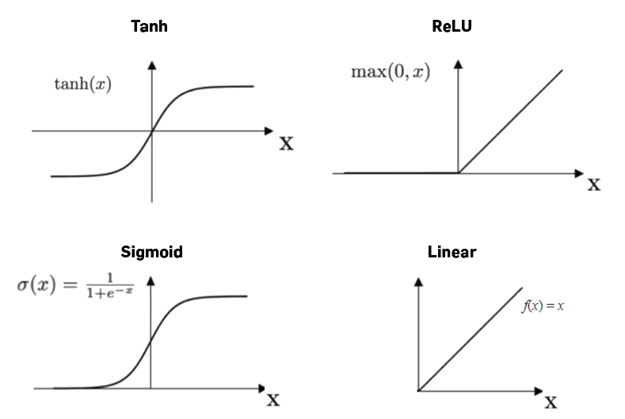
Activation function

Slide 10
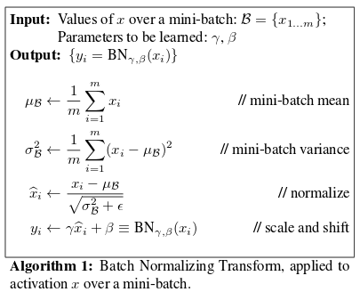
Batch Normalization

Slide 11
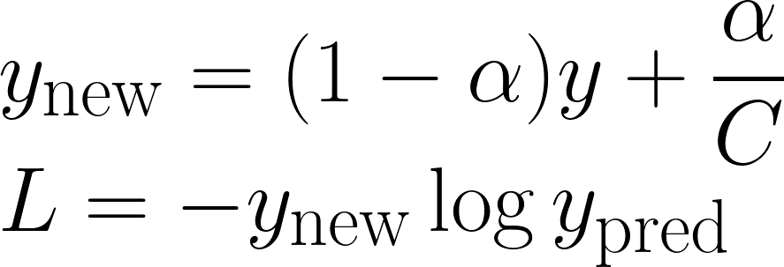
Label Smoothing

Slide 12
Frameworks

Slide 13
What we want from a framework?
Back Propagation
GPU
Not too complicated

Slide 14
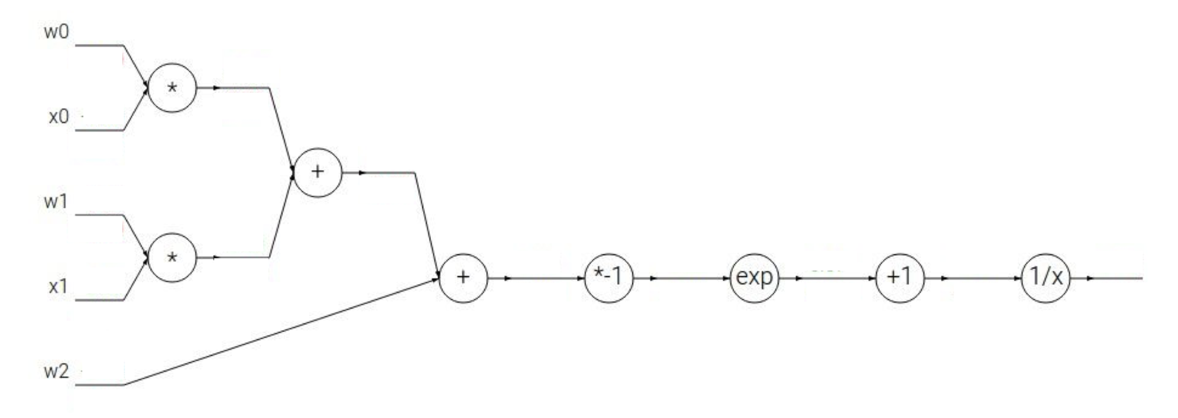
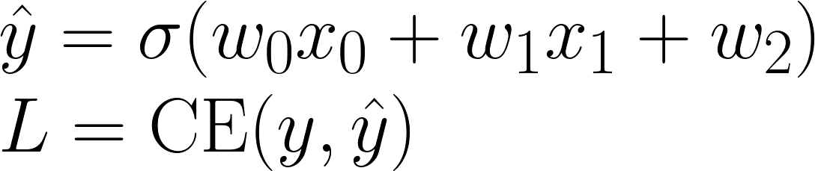
Computational Graph

Slide 15
Computational Graph

Slide 16
Static vs Dynamic
Static:
Compile graph once, use forever
“Faster”
“Harder” to write
Dynamic:
Build graph while computation
Easier to debug
Portability restrictions

Slide 17

Tensorflow & Keras

Slide 18

PyTorch

Slide 19
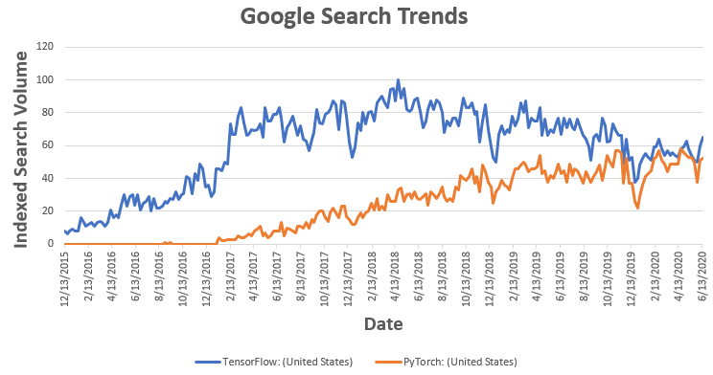
Pytorch vs Tensorflow

Slide 20
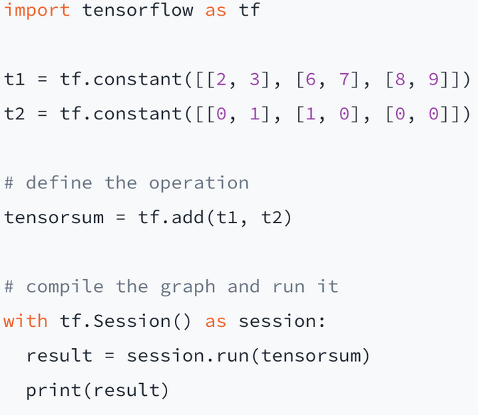
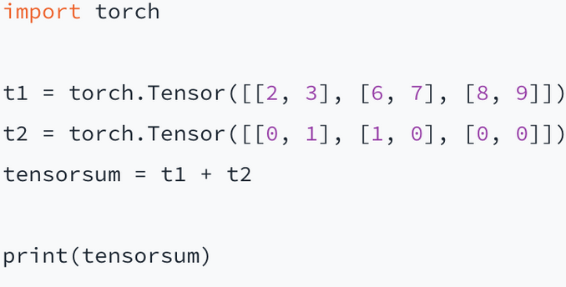
Pytorch vs Tensorflow

Slide 21
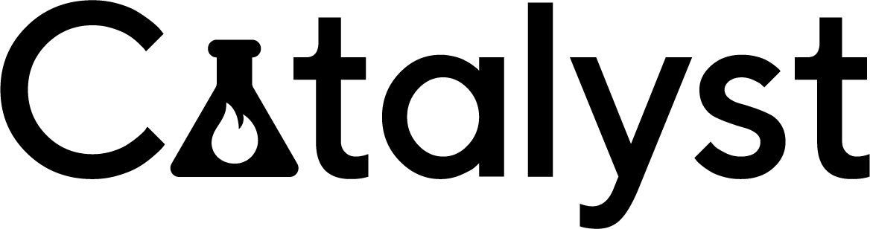
Catalyst

